Slide 1

Smart Kitchen
RIT ELECTRONICA

Slide 2


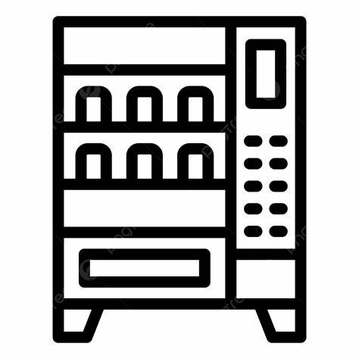
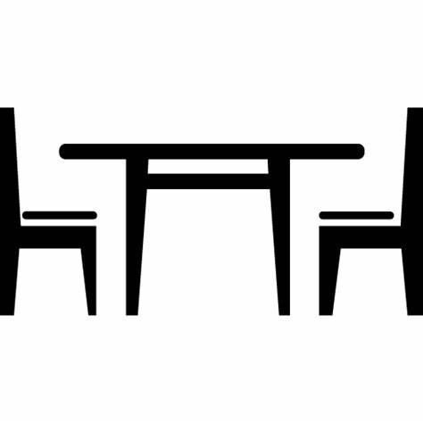
Business Logic
Applications Needed
Digital Payment
Just In Time Delivery
Vending Machine for Beverages
Arrival/Waiting time

Slide 3
Challenges
Slot Confirmation
SLOT 1 –Fixed allocation
SLOT 2 –Dynamic allocation
SLOT 3 – Tentative Allotment
Just In Time Delivery
In sync with customer’s arrival time

Slide 4


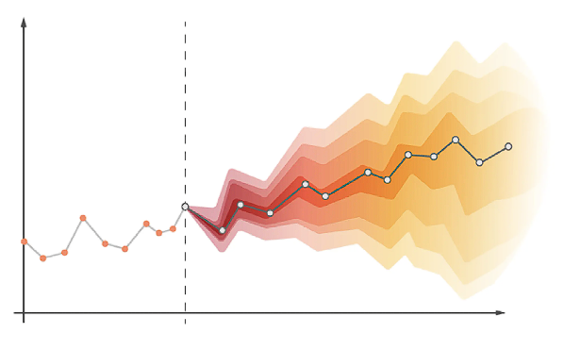


Application Tech Stack
Kubernetes
Microservices Architecture
Multiple Microservices
ARIMA Model

Slide 5
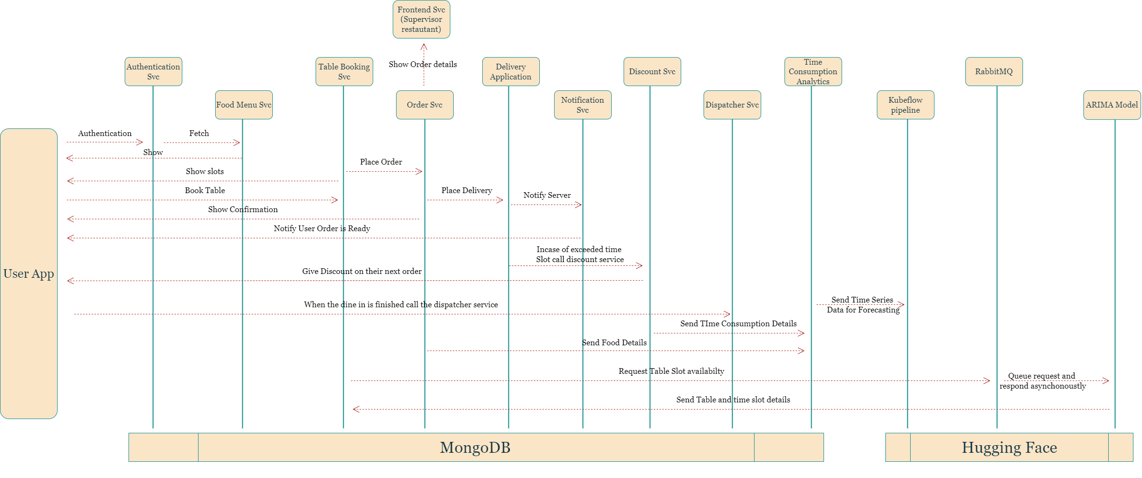
Architecture Diagram

Slide 6
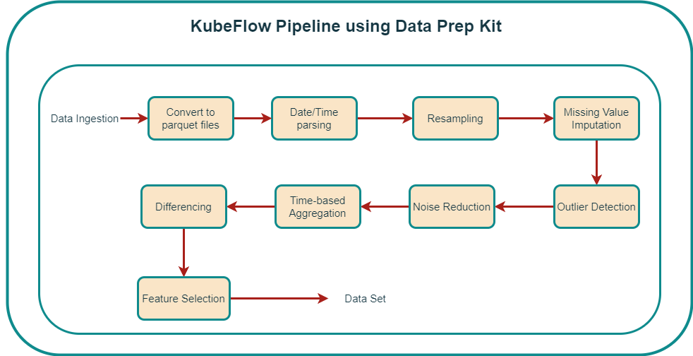
Data Preparation Pipeline

Slide 7
Thank You !
Mentor:
Prof. S. Jeeva
Team Members:
Baalekshan E
Arun M
Anbu Saran G
Sridhar S

